Slide 1
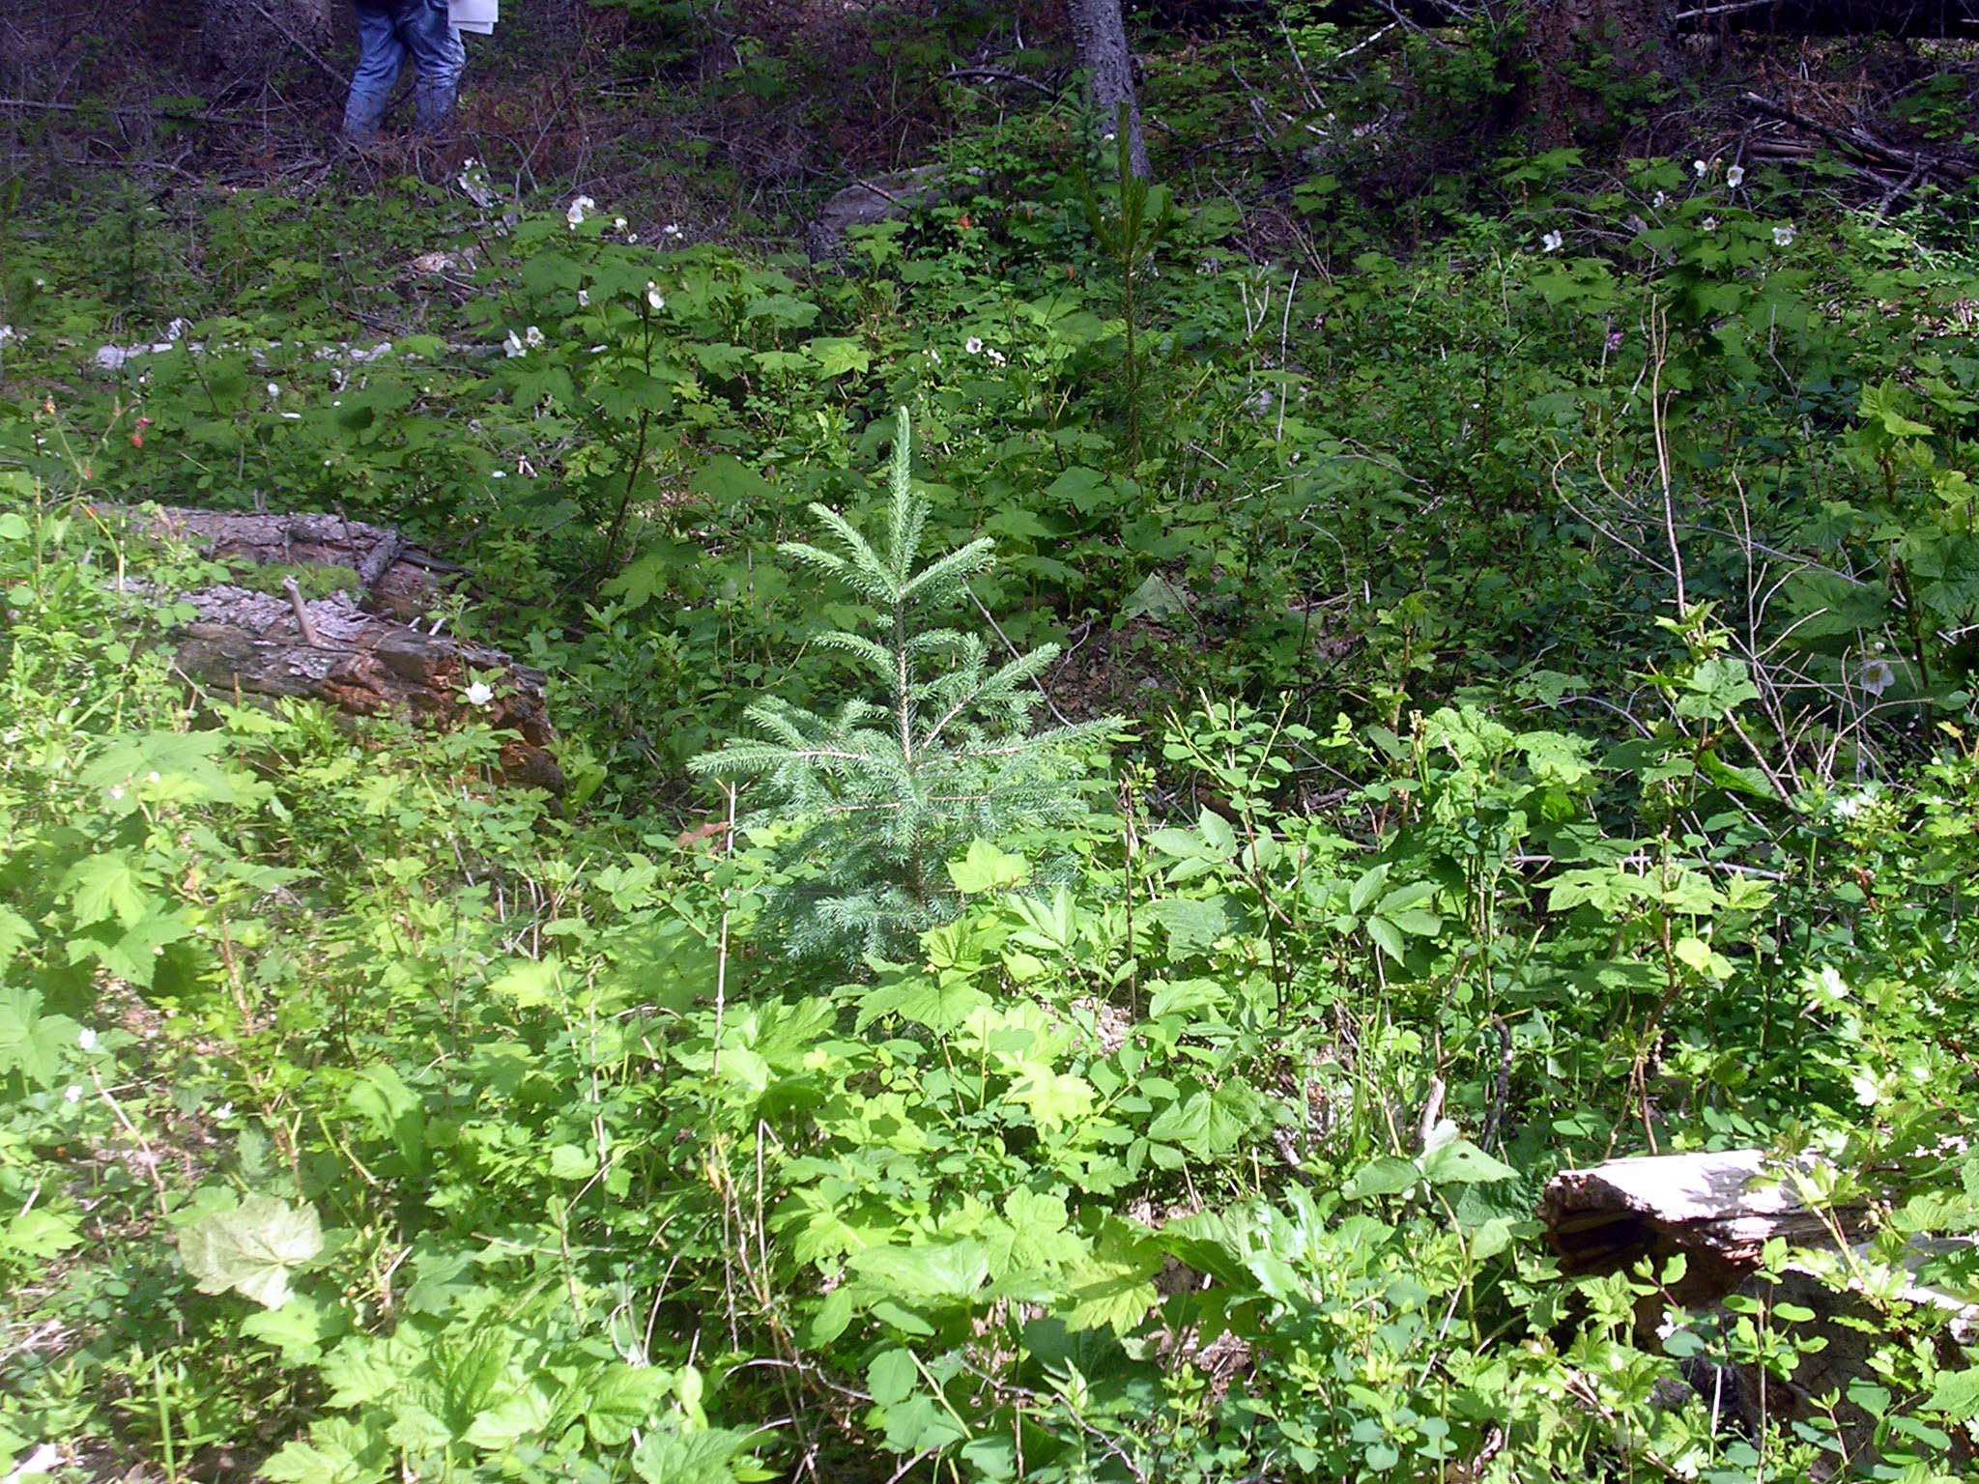

Stocking Standards 2011
Stocking Standard Content and Why it Matters
https://www.for.gov.bc.ca/his/results/training/Stocking-Standards.htm

Slide 2
Stocking Standards
OVERVIEW – legal direction
FRPA Obligations for Free-growing
FPPR provides clarity
FPPReg Schedule (s.6)
Factors to consider when designing standards
FPPReg Sec. 16
Must specify Situations and Circumstances that will apply.

Slide 3
Stocking Standards
Definition of stocking standards in Section 1 FPPR
"stocking standards" means the stocking standards that apply when
(a) establishing a free growing stand
or
(b) meeting the requirements of section 44 (4) – which covers commercial thinning, intermediate cuts and harvesting for special forest products.
Notes:
Factors relating to stocking specifications
6 (1) In this section:
"even-aged stand" means a stand of trees consisting of only one or two age classes;
"uneven-aged stand" means a stand of trees consisting of three or more age classes.
(2) The following factors apply to the development of stocking standards, generally:
(a) the long term forest health risks that are relevant to species selection for the purposes of establishing a free growing stand under section 29 [free growing stands] of the Act;
(b) the occurrence and extent of forest health factors.
(3) The following factors apply to the development of stocking standards under section 16 (2) [stocking standards]:
(a) for an area that is managed as an even-aged stand,
(i) the types of commercially valuable and ecologically suitable species that should be established on the area, and
(ii) the numbers and the distribution of healthy trees of a species referred to in subparagraph (i) that are required to adequately stock a free growing stand established on the area;
(b) for an area that is managed as an uneven-aged stand,
(i) the factors referred to in paragraph (a) that are applicable to those parts of the area that will be reforested,
(ii) the types of commercially valuable and ecologically suitable species that should be retained on the area, and
(iii) the characteristics, quantity and distribution of retained trees referred to in subparagraph (ii).
(4) The following factors apply to developing stocking standards under section 16 (4):
(a) the types of commercially valuable and ecologically suitable species that should be retained on the area;
(b) the characteristics, quantity and distribution of retained trees of a species referred to in paragraph (a), that are required to ensure the area will remain adequately stocked.

Slide 4

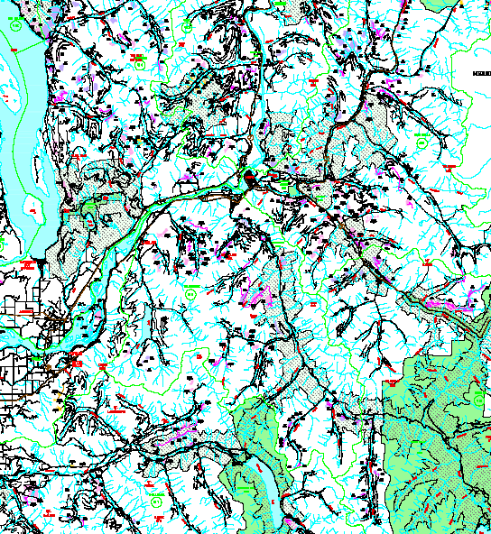

High Level Overview:
Full set of stocking standards for the FSP
All situations/circumstances covered?
All objectives / balance of objectives addressed?
Any Minister’s targets addressed?
Valuable species profile maintained or enhanced?
Standards sets in a form that is measurable and verifiable?
Examined in the context of all FDU’s under the FSP
Notes:
Minister’s targets – example: if 3 licencees are involved in a winter range and have split responsibilities between them – adjudicated by the Minister – he assigned the targets because licencees couldn’t agree.

Slide 5
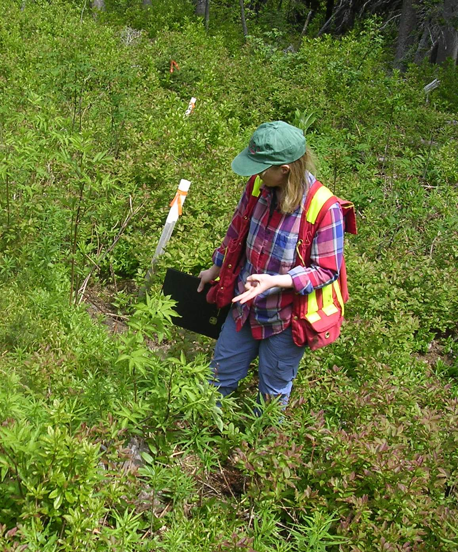
Stocking Standards: FACTORS
Even-aged Regen (1 age class)
FACTORS:
Long-term Forest health risks relevant to species selection
  AND occurrence and extent of those risks.
Commercially valuable and ecological suitable tree species
Numbers and Distribution of trees
Characteristics of trees required to maintain adequate stocking.

Slide 6
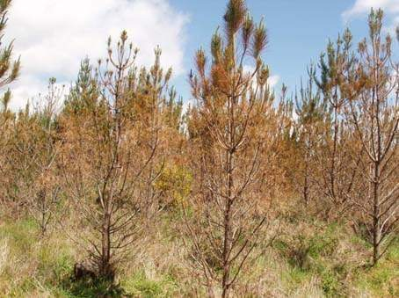
Stocking Standards:
FACTORS
FPPR Schedule (s.6)
Factors to consider when designing standards FOR ESTABLISHED OR RETAINED TREES:
Long-term Forest Health risks relevant to species selection
  AND occurrence and extent of those risks.
  Importance – e.g., mortality due to a forest health risk such as Dothistroma – where is it an issue?
  What about other forest health agents?

Slide 7
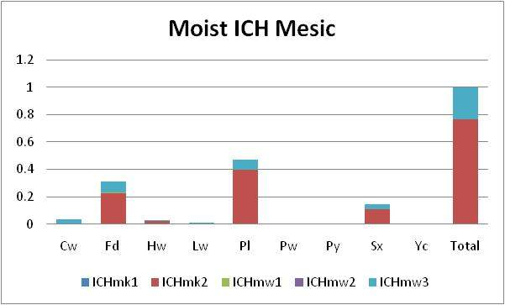
Stocking Standards:
FACTORS
1. Long-term Forest health risks relevant to species selection
  Other sources
  RESULTS runs of species planted by BEC unit – compared against risk factors – note the amount of Pl as a proportion planted.

Slide 8
Stocking Standards:
FACTORS
1. Long-term Forest health risks relevant to species selection
  Other sources – e.g., climate change analysis
  Kamloops Future Forest Strategy output for ICH to IDF transitional subzones (p. 81)
  Lodgepole pine plantations will see significant mortality as problems with rusts, root collar weevil and other pests increase. As these stands mature after 2050 they will likely see significant mortality from bark beetles. Stands mixed with other species (Douglas-fir, larch, ponderosa pine and white pine and broadleaf species) will see less mortality in general.
http://www.for.gov.bc.ca/hcp/ffs/KFFS_REPORT_ALL_June25-09.pdf

Slide 9
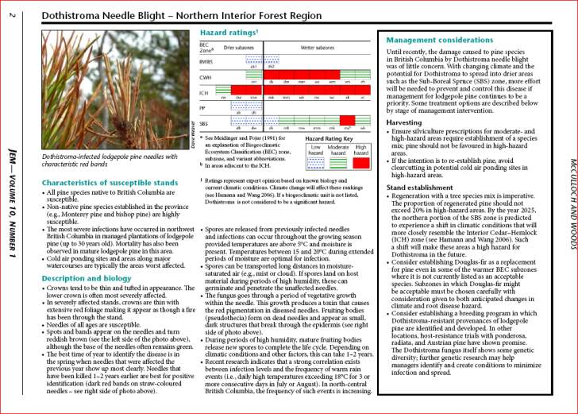
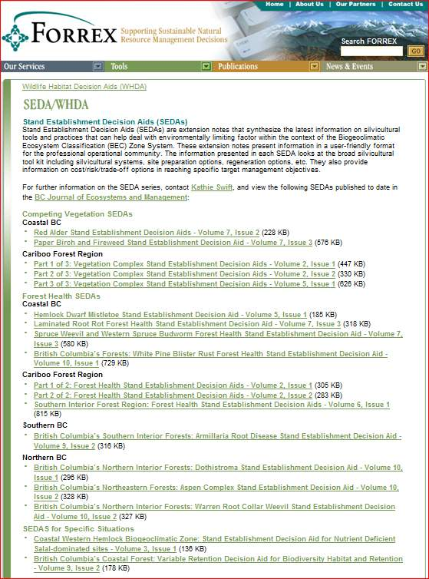
Stocking Standards:
FACTORS
Long-term Forest health risks relevant to species selection
  E.g., FORREX SEDAs
  http://www.forrex.org/tools/sedas/

Slide 10
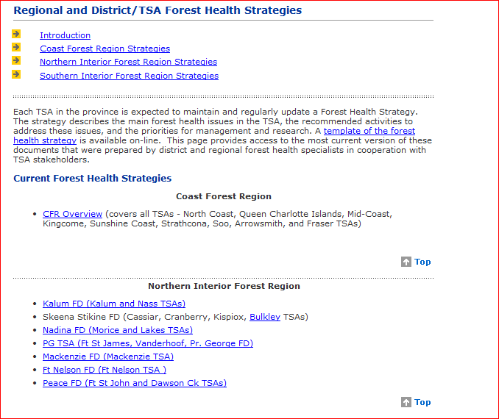
Stocking Standards:
FACTORS – Location of FH Strategies and more
Long-term Forest health risks relevant to species selection
  MFLNRO forest health website
  E.g., Location of District Forest Health Strategies
http://www.for.gov.bc.ca/hfp/health/index.htm

Slide 11
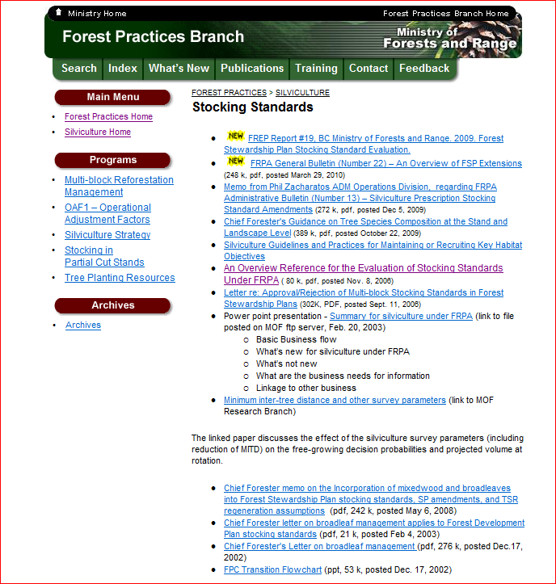
Stocking Standards:
FACTORS
FPPR Schedule (s.6)
Factors to consider when designing standards FOR ESTABLISHED OR RETAINED TREES:
2. Commercially valuable and ecological suitable tree species
http://www.for.gov.bc.ca/hfp/silviculture/stocking_stds.htm

Slide 12
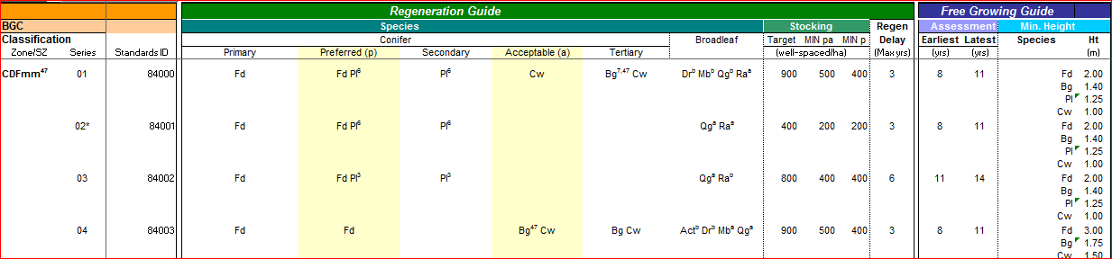
Stocking Standards:
FACTORS
2. Commercially valuable and ecological suitable tree species
The reference guide was based on extensive ecological and G and Y plot data filtered through expert opinion. It does not take into account climate change or new forest health information.
http://www.for.gov.bc.ca/ftp/hfp/external/!publish/Stocking%20Standards%20for%20FDPs/Reference_Guide.xlsm
Notes:
http://www.for.gov.bc.ca/hfp/silviculture/Silviculture_Surveys.html has a ton of links too.

Slide 13
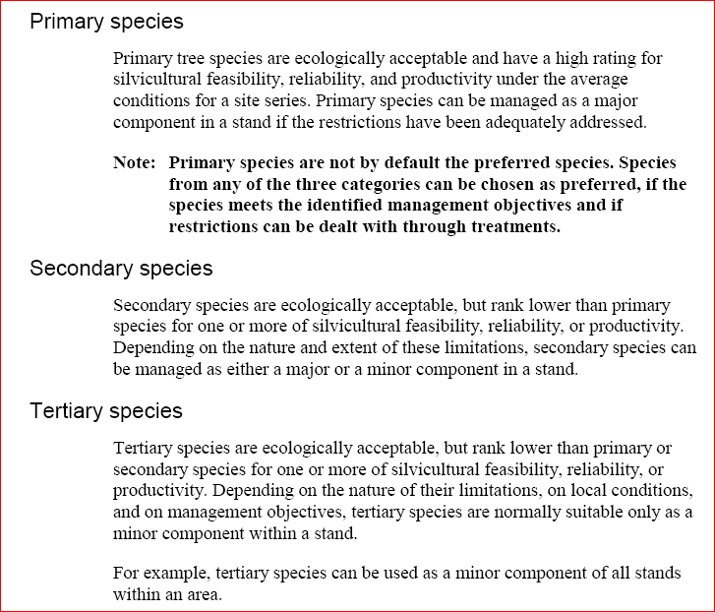
Stocking Standards:
FACTORS
2. Commercially valuable and ecological suitable tree species
The key elements are:
  Feasibility
  Reliability and
  Productivity
Notes:
http://www.for.gov.bc.ca/hfp/silviculture/Silviculture_Surveys.html has a ton of links too.

Slide 14
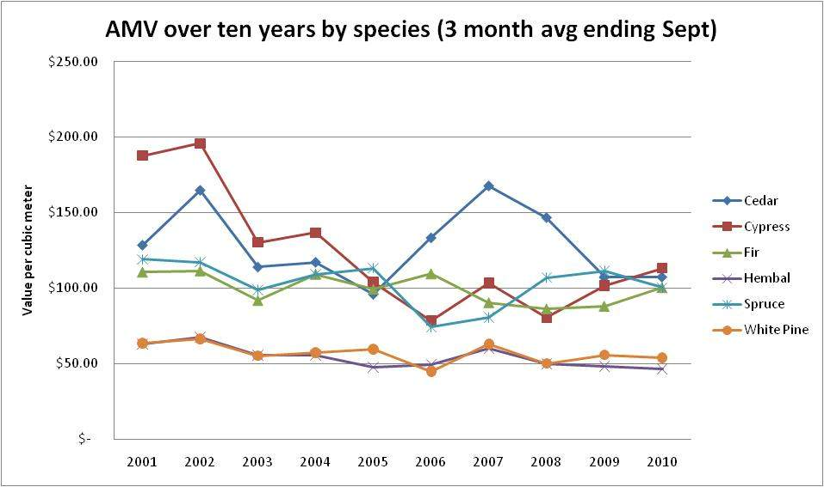
Stocking Standards:
FACTORS
Commercially valuable and ecological suitable tree species
Coastal example 2000 - 2010
Source MFML weblink
http://www.for.gov.bc.ca/hva/logreports.htm
Notes:
Source MFML weblink http://www.for.gov.bc.ca/hva/logreports.htm

Slide 15
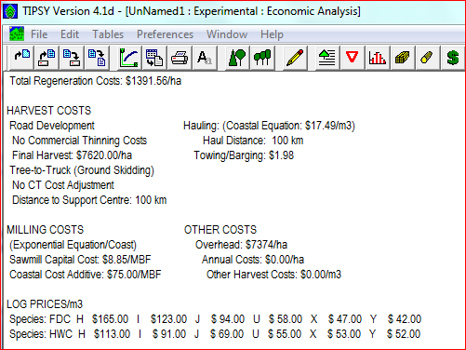
Stocking Standards:
FACTORS
Commercially valuable and ecological suitable tree species – TIPSY OUTPUT
Notes:
Source MFML weblink TIPSY version 4.1d

Slide 16
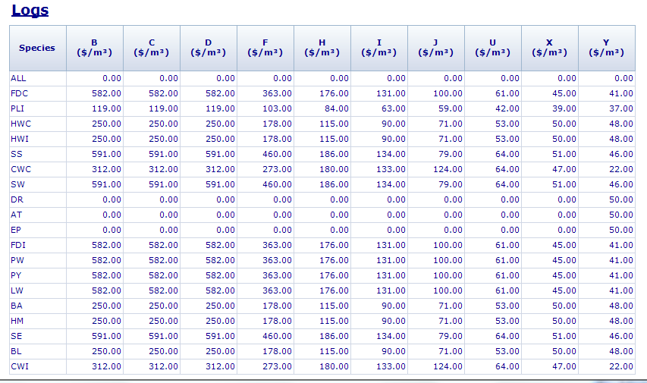

Slide 17
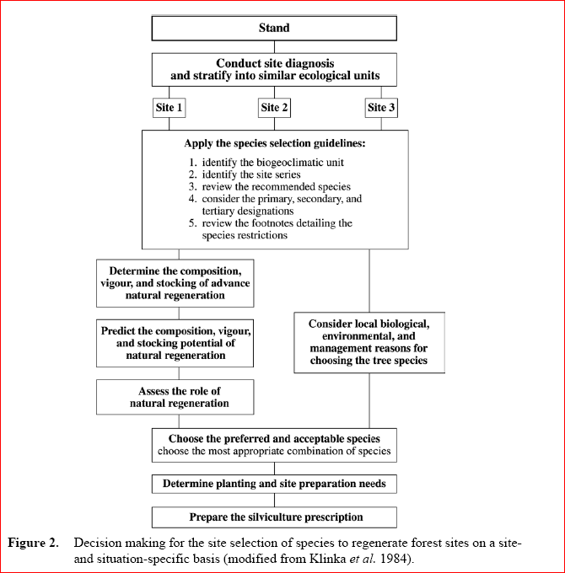
Stocking Standards Species Selection:
Notes:
http://www.for.gov.bc.ca/hfp/silviculture/Silviculture_Surveys.html has a ton of links too.

Slide 18
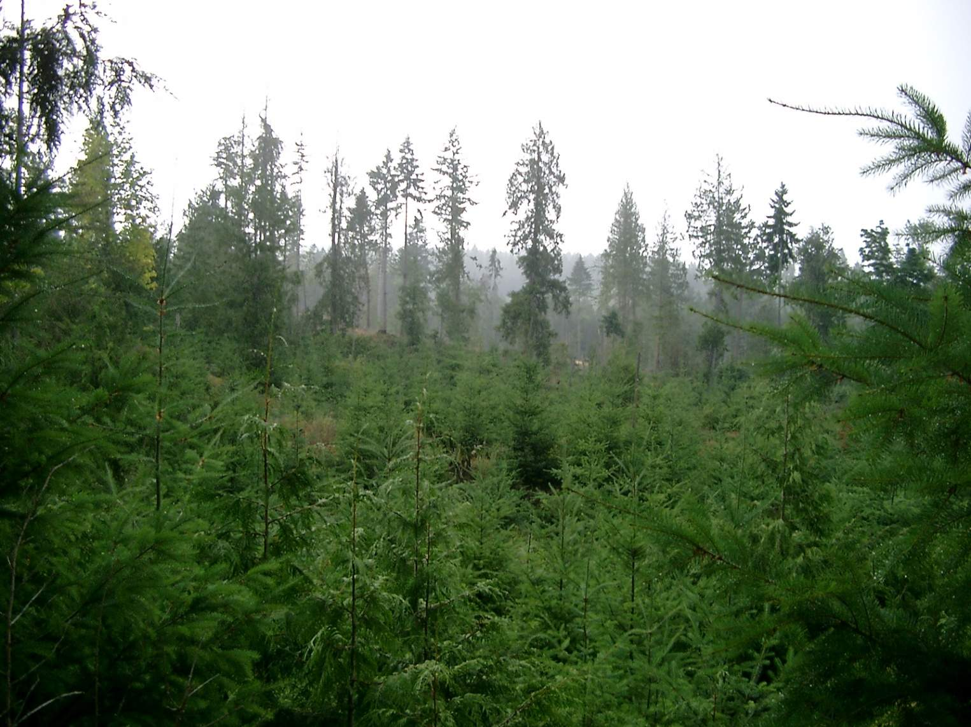
Stocking Standards: FACTORS
FACTORS:
3. Number and Distribution of trees
Minimum and upper density
Minimum inter-tree spacing and M value

Slide 19
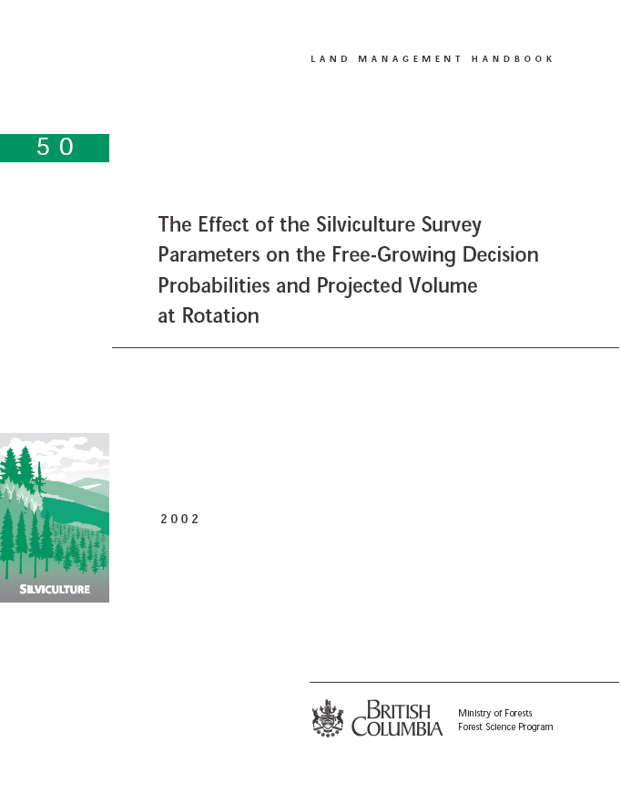
Stocking Standards: FACTORS
FACTORS:
3. Number and Distribution of trees

Slide 20
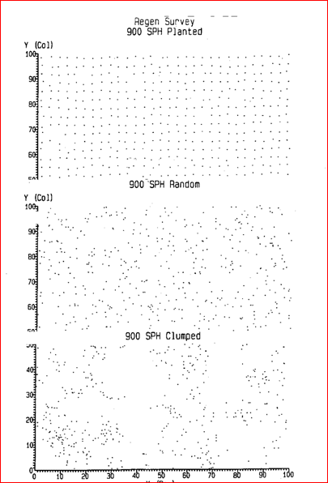
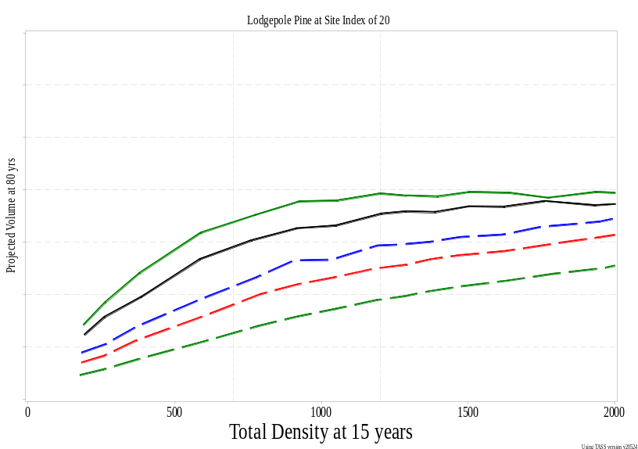
Projected Merch Volume (80 yrs) vs Total at 15 years (SI = 20)
Large difference between regular spacing – green line, then random spacing – black line and the three clumpy distributions – dashed lines
What does this mean for forecasting timber supply?
Notes:
Top line: regular, then random then 3 different clumpy distributions

Slide 21
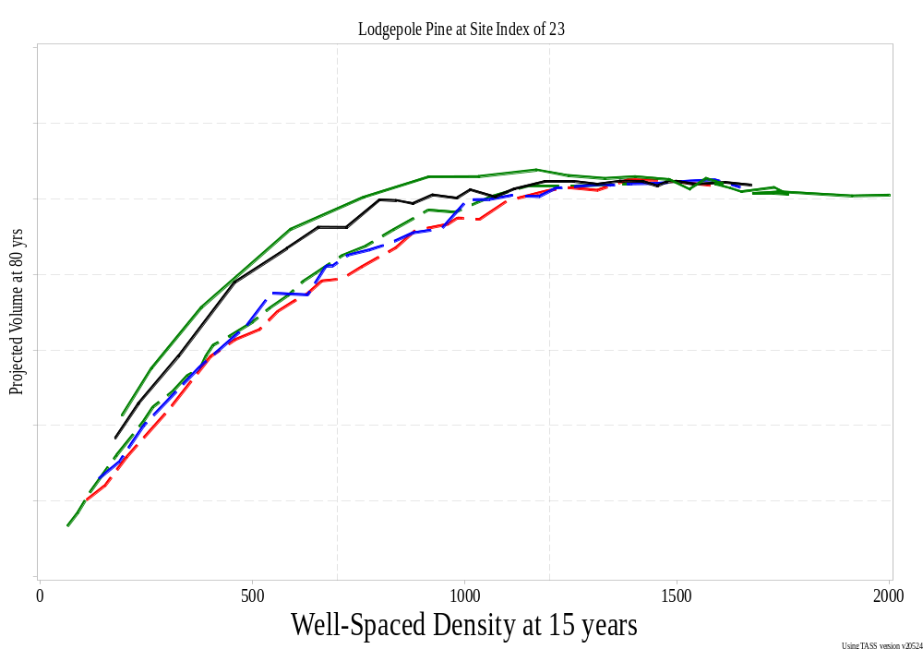
Projected Merchantable Volume vs WS at 15 years
TSS
MSS
Note convergence with the different distributions at Target WS Stocking – remain varied with MSS
Notes:
Top line: regular, then random then 3 different clumpy distributions (blue, red, green)

Slide 22
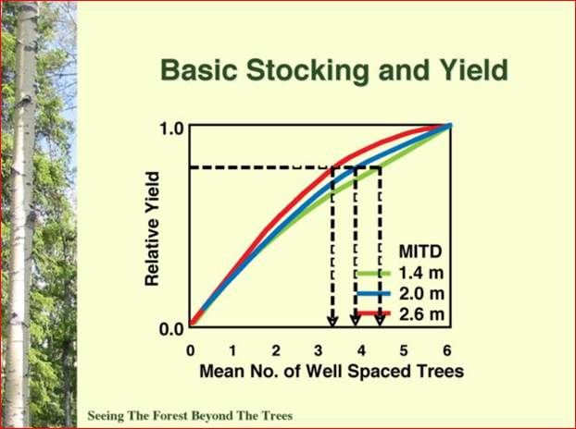
MITD and Projected Volume Losses
This indicates a MSS of 700 at 2.6 m spacing provides similar yield to a MSS of 900 for MITD of 1.4m
Slide courtesy of Dr. Craig Farnden
Notes:
Note that target stocking provides a relatively constant volume loss. IF the intent of lowering the MITD to better reflect target stocking that is a valid approach and provides reasonable volume outputs. Where it is used to compensate for poor stratification, it will result in significant volume reductions from those assumed for higher MITD runs.

Slide 23
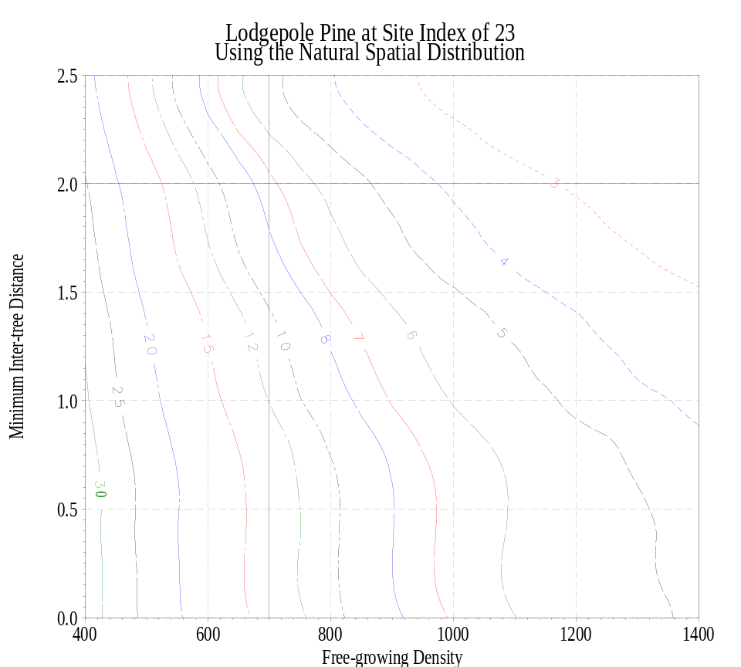
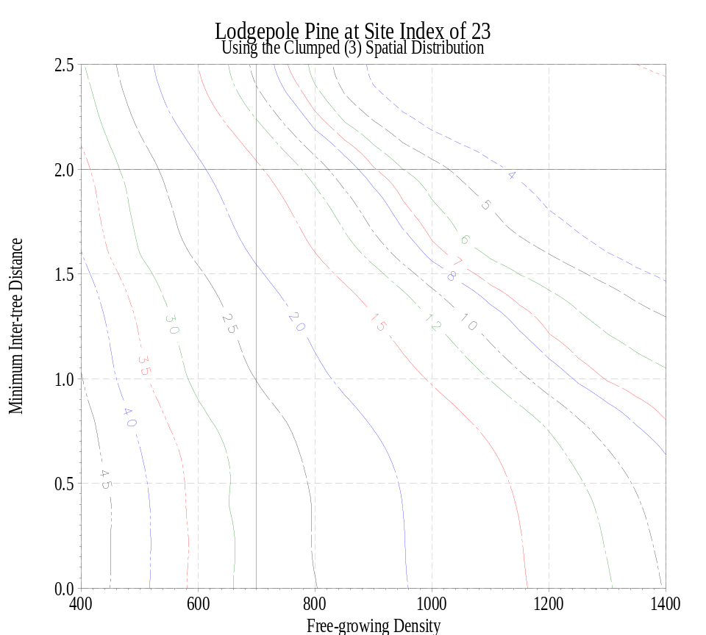
At TSS and MITD = 2 m, volume losses similar regardless of spatial distribution
Natural distribution
Clumped Distribution

Slide 24
At TSS and MITD = 1.5 m, volume losses differ significantly with clumped distribution
Natural vs Clumped – 10 vs 20 % reduction

Slide 25
Stocking Standards: SUMMARY
FRPA Obligations for Free-growing
FPPR provides clarity
FPPR Sec. 16
Must specify Situations and Circumstances that will apply.
FPPR Schedule (s.6)
Factors to consider when designing standards…
Geog. Location / site characteristics / total ha?
Forest Health, Ecol. Suitability, Commercial Value factors
Amount, distribution, characteristics
Factors can apply to understory and/or overstory.

Slide 26
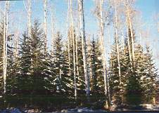
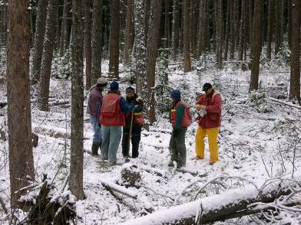
Discretionary Approval
PURPOSE:
Step 3b FPPR Tests:
Sec 26 (5)
Sec 26 (3)(a-b)
PURPOSE:
New situations, priorities etc
Allows for innovation
Situations where appropriate standards are not currently consistent with TSR.

